Slide 1
LUNGS DISEASE DETECTION USING DEEP LEARNING

Slide 2



HELLO!
ADNAN KHAN
15009065330
BS SE
ALI ZAIB
15009065245
BS SE
SAAD MASOOD
15009065339
BS SE

Slide 3
BACKGROUND
1
Some Stats On Lungs Cancer

Slide 4
Lungs Cancer Statistics
1 in 16 people in the US will be diagnosed with lung cancer in their lifetime.
More than 228,000 people in the US will be diagnosed with lung cancer this year, with a new diagnosis every 2.3 minutes.
60% to 65% of all new lung cancer diagnoses are among people who have never smoked or are former smokers.
10% to 15% of new lung cancer cases are among never-smokers.

Slide 5
Some more stats….

Slide 6
Pre Processing Stage
2
A prior stage

Slide 7
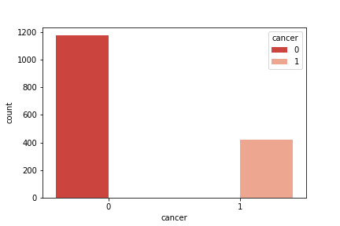
Pre Processing
The Data Set: DSB ’17, 1595 patients
Luna ‘16: 888 patients

Slide 8
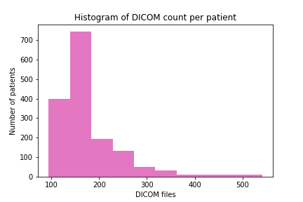
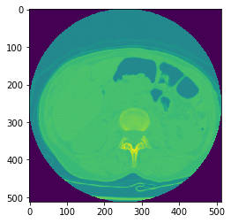
Pre Processing
Visualizing raw data

Slide 9
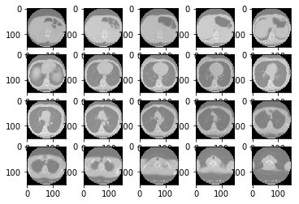
Pre Processing
Resizing into 150x150x20
Saved in a numpy array

Slide 10
Modal Selection
2
2D and 3D CNN

Slide 11
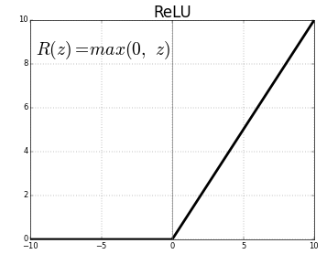
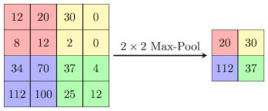
Convolutional Neural Network
Convolutional Layer
Activation Function
Max Pooling

Slide 12
2D CNN - Keras
Input: Each data is an individual input (64x64)
Result: 59% Accuracy on Validation Data

Slide 13
3D CNN – Tensor Flow
Batch Data:50x50x20/patient
Result: 68% Accuracy on Validation Data

Slide 14
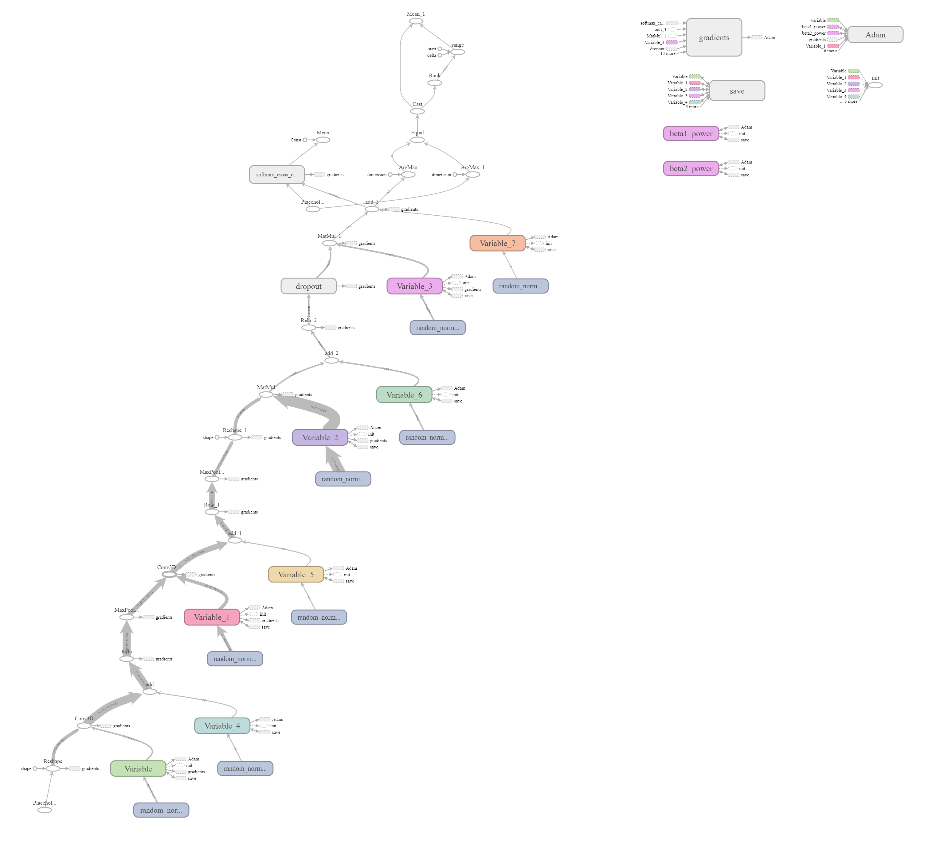
3D CNN

Slide 15
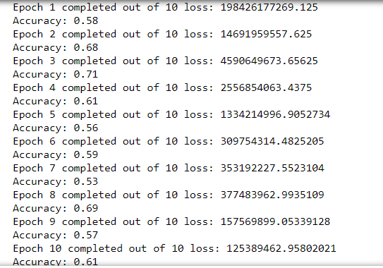
3D CNN
10 Epochs, Accuracy on Validation Data

Slide 16
Future Work
3
Web and Mobile Application

Slide 17
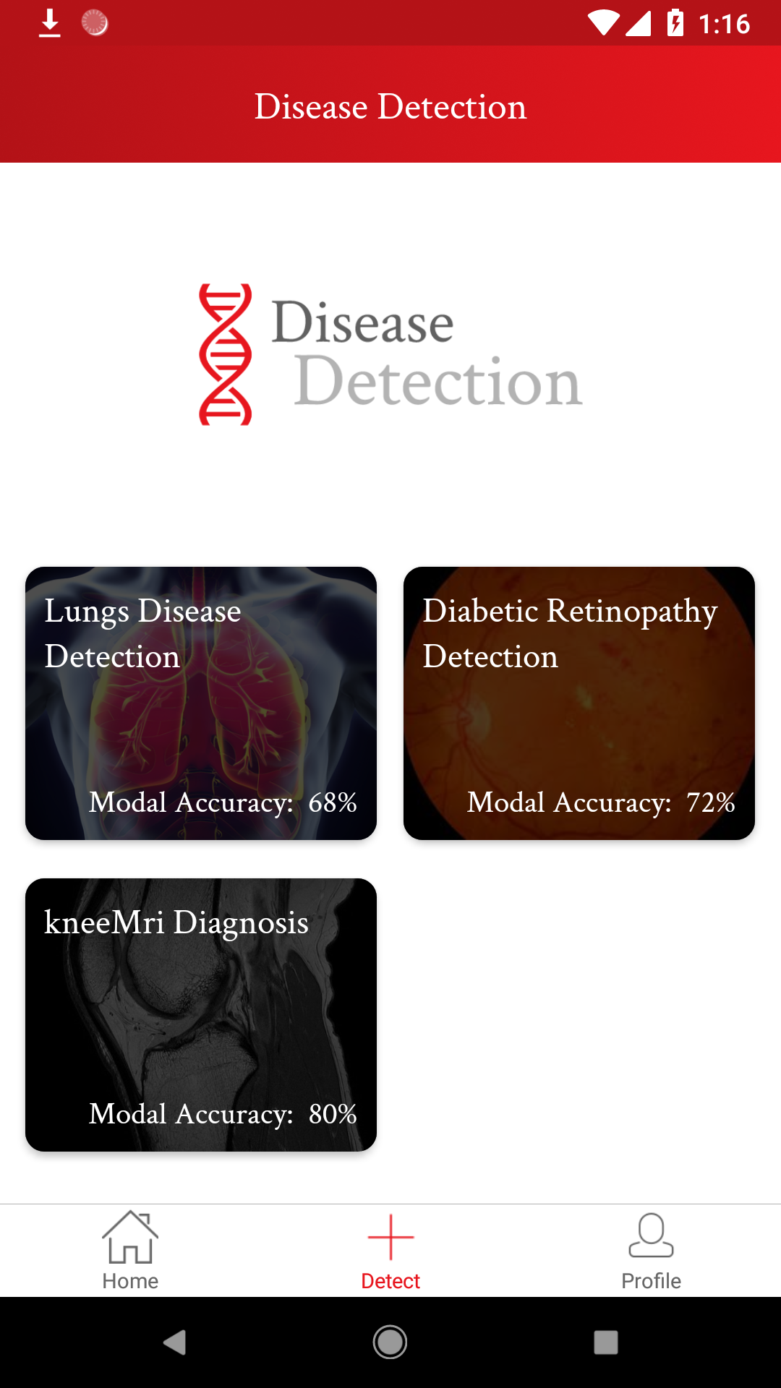
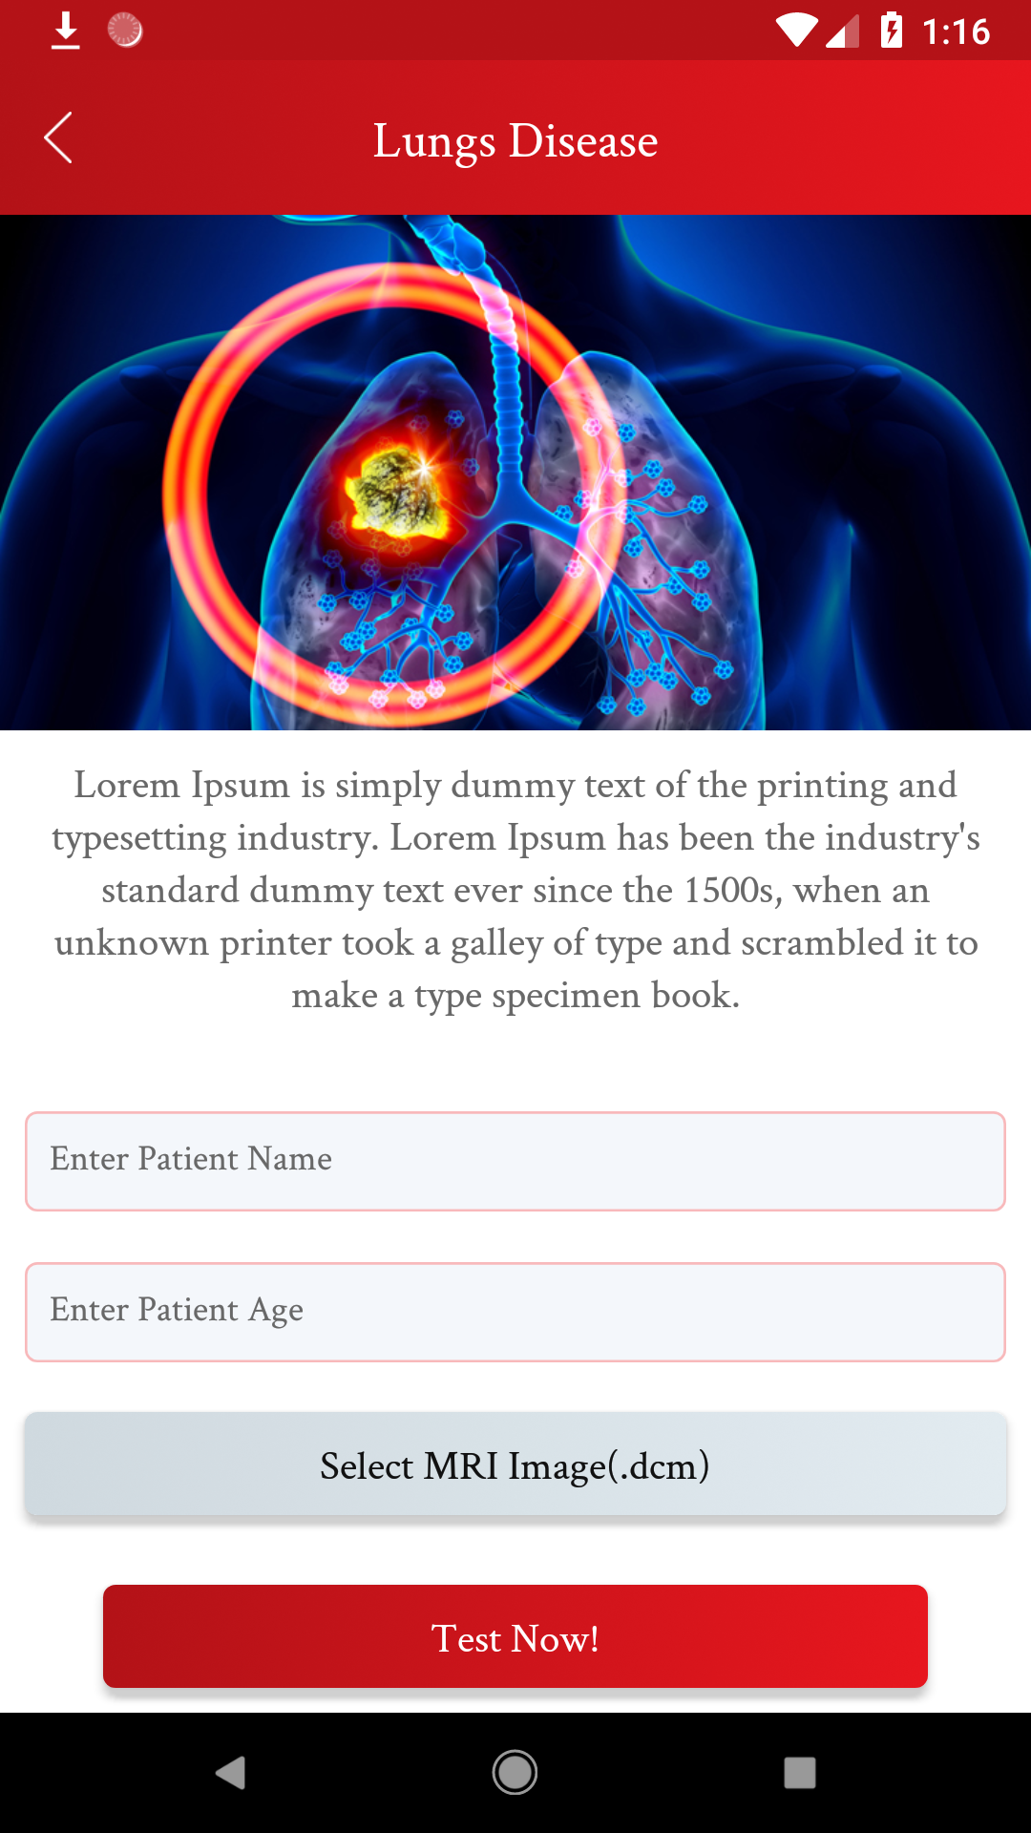
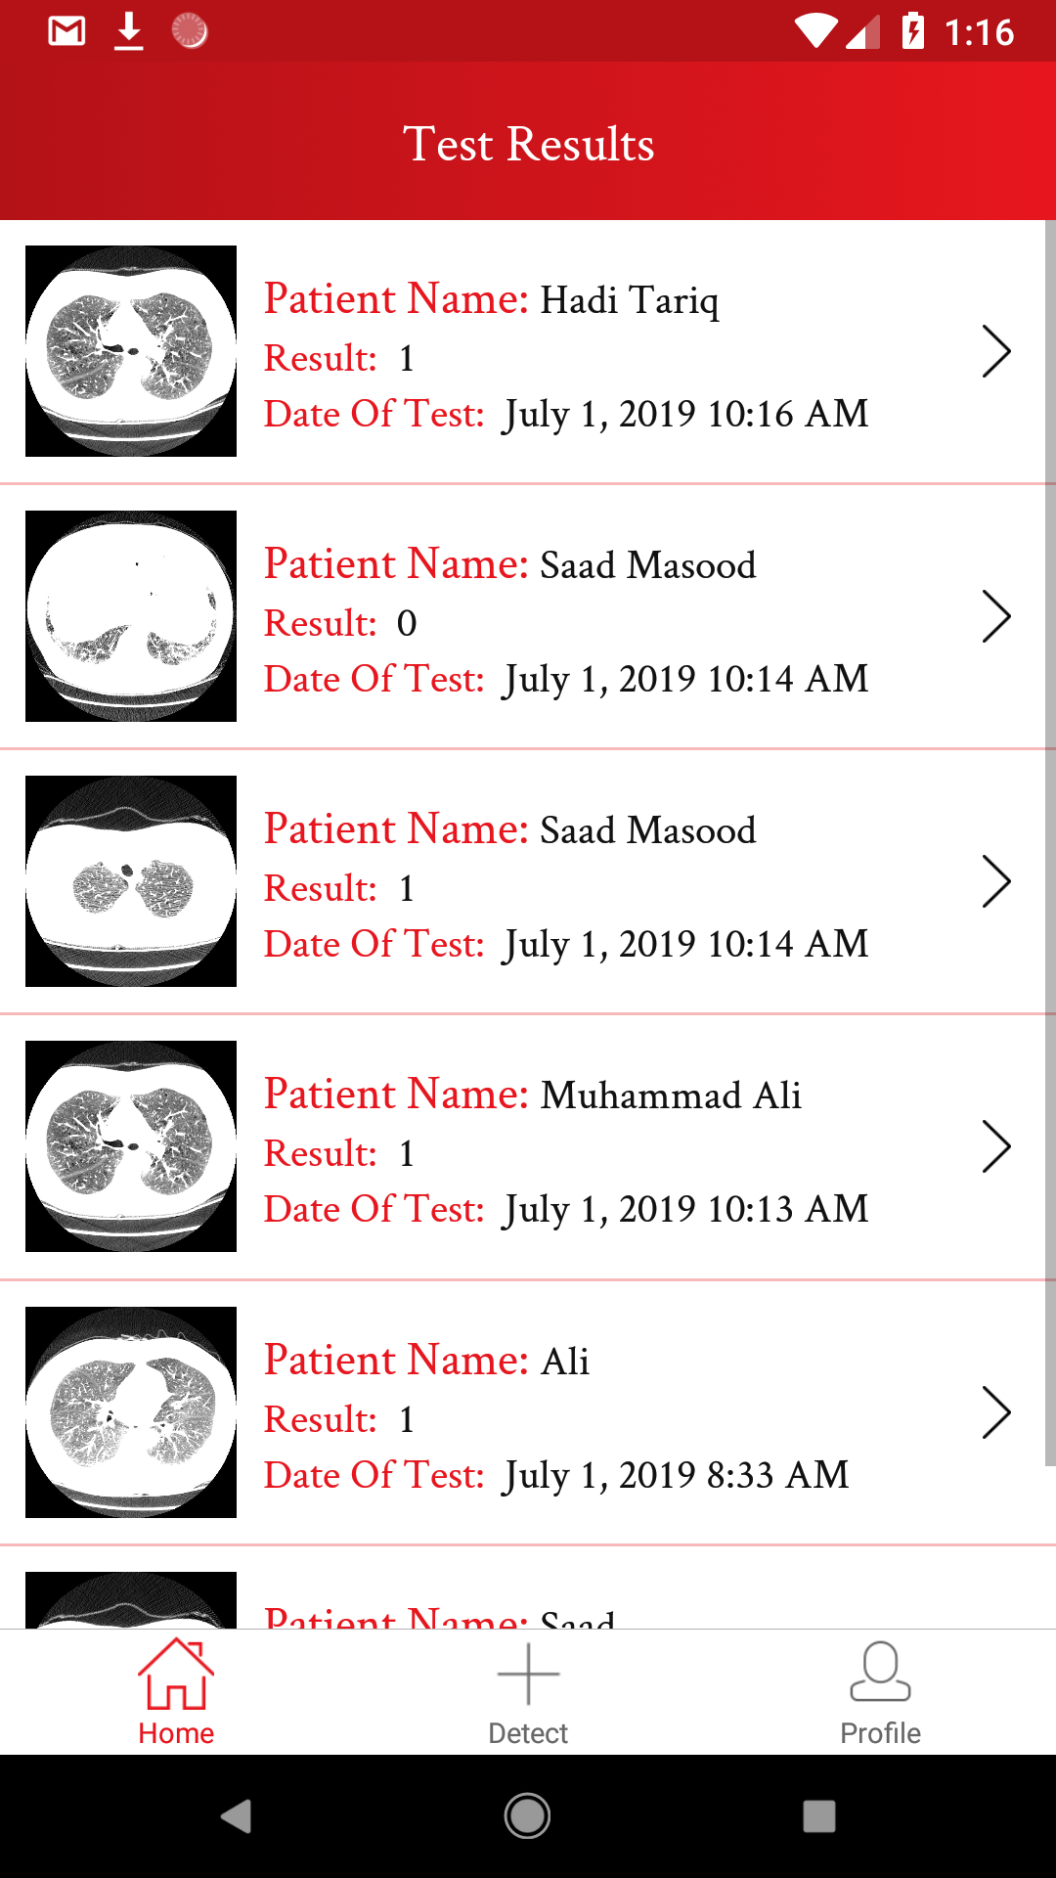
Mobile Application

Slide 18
THANKS!
Any questions?

